Slide 1
Automated Analysis of Survey Data using STATA
Presented By:
Vinay Patel
Deputy Manager, SA & S Group
National Dairy Development Board
@ STATA Usergroups Conference 2013

Slide 2
Background
Prior to using STATA
Survey Data Characteristics
Estimation of Important Variables
Automation of Survey data analysis
Important Commands-need to know
Interface between GIS and STATA

Slide 3
Background
Types of Activities
Various Surveys
Repetitive Surveys
Survey procedures
Vinay A. Patel Automated Analysis of Survey Data using STRATA N.D.D.B

Slide 4
Prior to using STATA
Time required @ every stage
Data Collection
Data Analysis in EXCEL
Hypothesis Testing
Report Preparation
Vinay A. Patel Automated Analysis of Survey Data using STRATA N.D.D.B

Slide 5
Survey Data Characteristics
Single-Stage Design:
  svyset [ psu ] [ weight ] [, strata (varname) fpc (varname) ]
  Primary Sampling Unit (psu)
  Sampling weights-pweight
  Strata
  Finite Population Correction (fpc)
svyset VILLAGE [pweight=invweight], strata(QUADSTRATA) fpc(FPC) poststrata(PSTRATA) postweight(THLACTHH) vce(linearized)
Vinay A. Patel Automated Analysis of Survey Data using STRATA N.D.D.B

Slide 6
Multi-Stage Design:
  svyset psu [weight] [ , strata (varname) fpc (varname) ]
  [ || ssu [ , strata (varname) fpc (varname) ]
  Stages are delimited by “||”
  SSU – secondary / subsequent sampling units
Vinay A. Patel Automated Analysis of Survey Data using STRATA N.D.D.B

Slide 7
Estimation of Important Variables
Important Variables
  Social Category
  Economic Category
  Village Surplus
  Milch Animals
  Milch Animals’ Yield
  Producer Surplus
  Milk Production
  Size of Family
  Milch Animal Households
Vinay A. Patel Automated Analysis of Survey Data using STRATA N.D.D.B

Slide 8
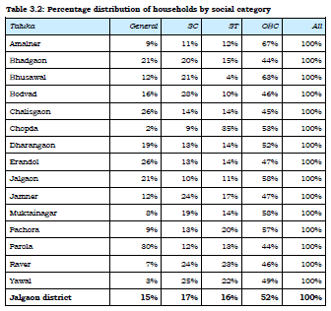
Problem: % Distribution of Households by Social Category
Through Stata command
Through Pivot table in excel
tabulate Tehsil CASTE if CASTE > 0, nofreq row
svy linearized : proportion CASTE,over(PSTRATA) cformat(%9.2f)
Vinay A. Patel Automated Analysis of Survey Data using STRATA N.D.D.B

Slide 9
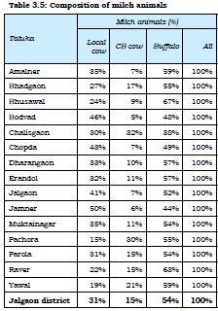
Problem: Composition of Milch Animals (%)
Through Stata command
Through Pivot table in excel
tabstat lcper cbper bfper totaniper, by(Tehsil) columns(variables) format(%9.0f)
svy linearized : total LCIM CBIM BFIM inmilk lc cb bf MilchAnimal, over (PSTRATA) cformat(%9.2f)
Vinay A. Patel Automated Analysis of Survey Data using STRATA N.D.D.B

Slide 10
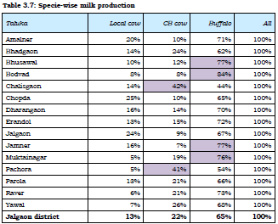
Problem: Estimated Milk Production Species-wise
Through Stata command
Through Pivot table in excel
tabstat lcshare cbshare bfshare allshare, by(Tehsil) columns(variables) format(%9.0f)
svy linearized : total LCPROD CBPROD BFPROD TOTPROD, over(PSTRATA) cformat(%9.0f)
Vinay A. Patel Automated Analysis of Survey Data using STRATA N.D.D.B

Slide 11
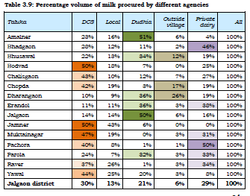
Problem: Milk Procured by different Agencies
Through Stata command
Through Pivot table in excel
tabstat sldcsper sllocalper sldudhiaper sloutvillper slpvtdairyper totsaleper, by(Tehsil) columns(variables) format(%9.2f)
svy linearized : total SLDCS SLLOCAL SLDUDHIA SLOUTVILL SLPVTDAIRY totalsale, over(PSTRATA) cformat(%9.2f)
Vinay A. Patel Automated Analysis of Survey Data using STRATA N.D.D.B

Slide 12
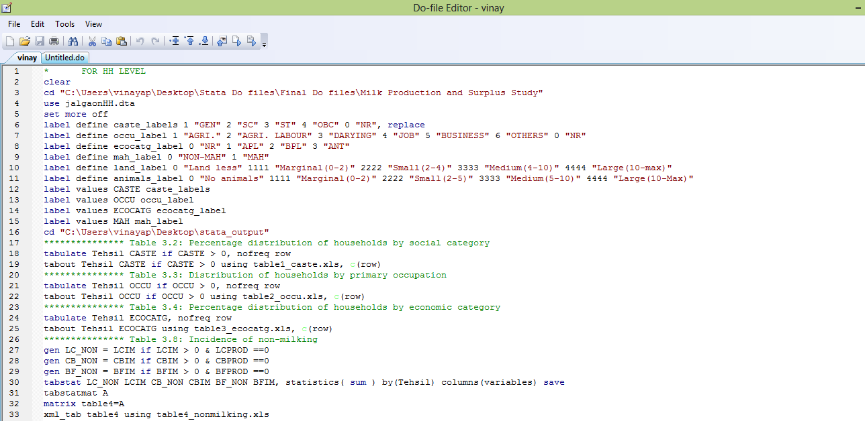
Automation of Survey data analysis
Create a Do-file
Convert into ado-file
Use same do or ado-file for repetitive use

Slide 13
Important Commands-need to know
For Export of tables
    tabout
    xml_tab
    outreg2
    collapse
For graphs
    tableplot
    vioplot
    tabplot
    catplot
Vinay A. Patel Automated Analysis of Survey Data using STRATA N.D.D.B

Slide 14
Interface between GIS and STATA
spmap - Visualization of spatial data
shp2dta using shpfilename, database(filename) coordinates(filename) [options]
spmap DCSSALE using thlscoor.dta, id(_ID) title("Sold to DCS as a % of Total Sale in Tehsil") fcolor(white gs15 ltkhaki ltblue ) point( xcoord( x_c) ycoord( y_c) proportional( DCSSALE) size(*2) fcolor(eltgreen) ocolor(white)) label( xcoord( x_c) ycoord( y_c) label( teh_dcs) size(*.5))
Vinay A. Patel Automated Analysis of Survey Data using STRATA N.D.D.B

Slide 15
THANK YOU
Vinay A. Patel Automated Analysis of Survey Data using STRATA N.D.D.B

